Slide 1



GEEKSTORM
Team Number : 80
Problem Statement Title : ManoMitra
(An AI based mental health support system).
Team Name : Data Pirates.
Project Name: ManoMitra

Slide 2
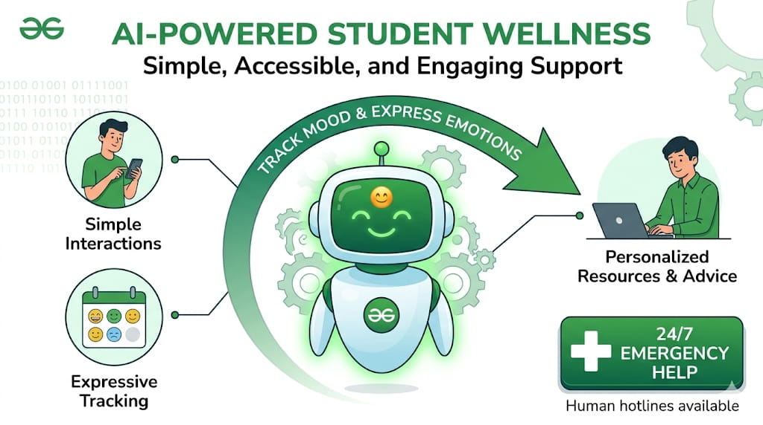
GEEKSTORM
PROBLEM STATEMENT
Many students face stress and anxiety but avoid seeking help due to stigma and limited access. Existing solutions are often complex and unengaging. There is a need for a simple, accessible platform to track mood and express emotions. The goal is to develop an AI-powered assistant providing personalized support, engagement, and emergency help anytime.

Slide 3
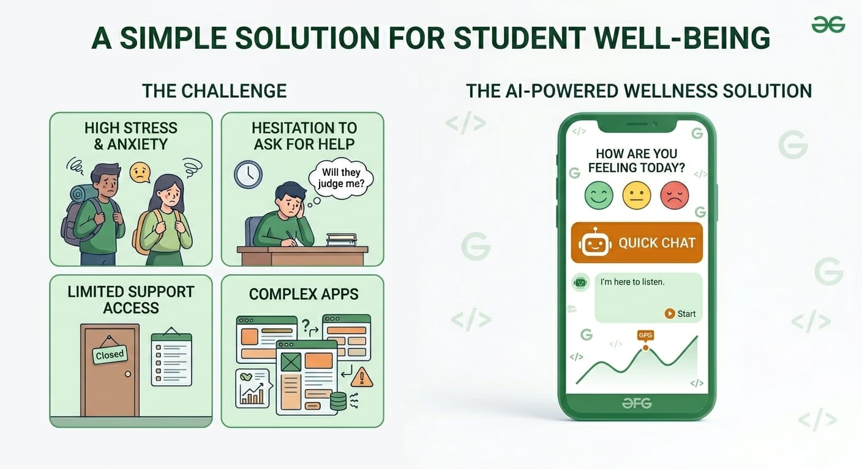
GEEKSTORM
🚩 Challenge Statement
Students face stress and anxiety
People hesitate to ask for help
Mental health support is not easily available
Existing apps are complex and not user-friendly
Need a simple, safe, and accessible solution
Provide AI-based support and mood tracking

Slide 4
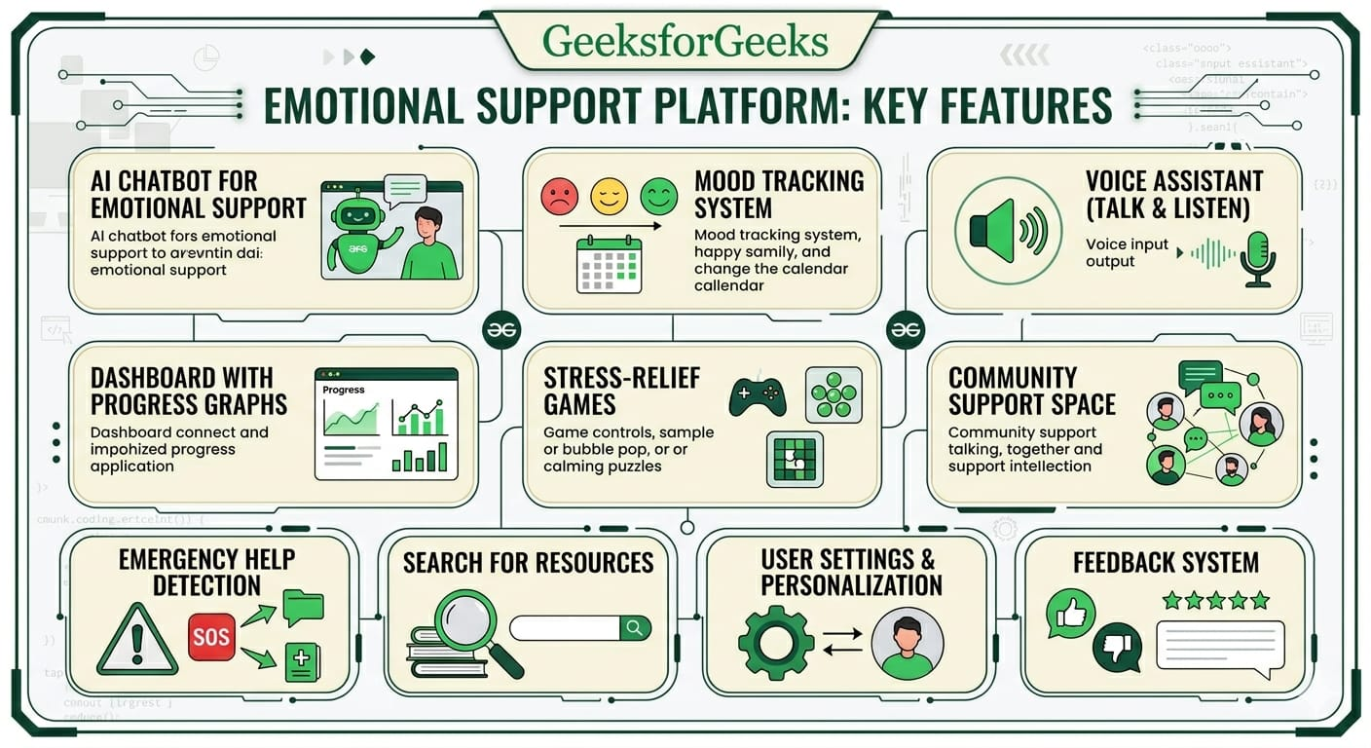
GEEKSTORM
Key features
🤖 AI Chatbot for emotional support
😊 Mood tracking system
🎤 Voice assistant (talk & listen)
📊 Dashboard with progress graphs
🎮 Stress-relief games
👥 Community support space
🚨 Emergency help detection
🔍 Search for resources
⚙️ User settings & personalization
💬 Feedback system

Slide 5
GEEKSTORM
Proposed Prototype Link :
https://d98f05a1-427a-44c9-8daa-1893a9a350f6-00-2zybn970ws2ot.spock.replit.dev/
video link:
https://youtu.be/mEFySXZEV0w?si=D0yKrmjuLoYyZrqb
Github link:
https://github.com/pravallikagangavaram/ManoMitra

Slide 6
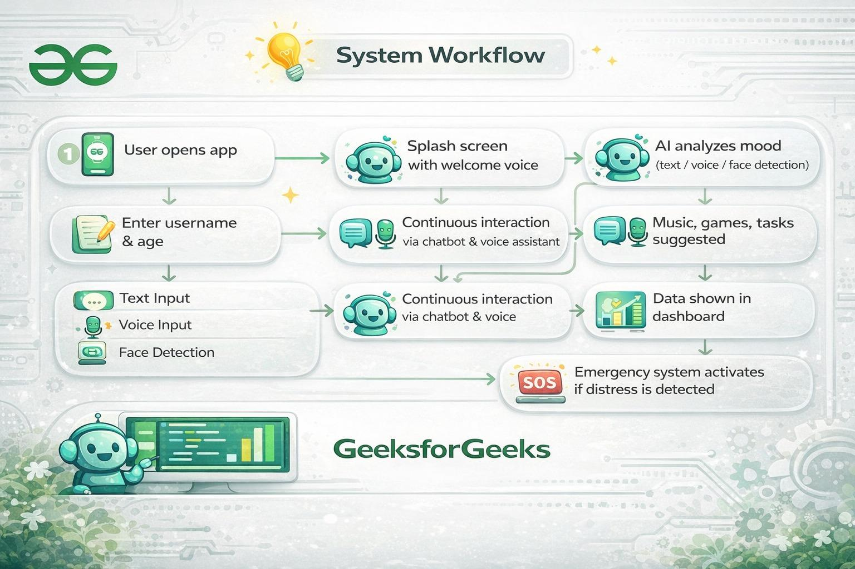
GEEKSTORM

